Slide 1

Health care cost analysis for a health management organization
Predict people who will spend a lot of money on health care next year and provide a recommendation on how to lower the health care cost
Present by
Kanishk Gupta
Rajat Chelani
Bastin Bajiyo Job
Kartik Kaul

Slide 2
PROJECT GOAL
The data available is based on patients' health care costs
The workings of the project consist of using various data analysis techniques and models to support the interpreted recommendations, driven by correlational trends between the various parameters present in the health care data set.
Focus Point
People who spend a lot of money on health care?
The factors attributing to higher costs.
How to lower the HMO’s total health care cost?
Age category and location specific recommendation to lower the costs.

Slide 3
PROJECT AGENDA
Phase1:
Load the data with appropriate libraries
Phase 2:
Explore the data
Phase 3:
Data Cleaning
Phase 4:
Overview of important variables
Phase 5:
Data Modeling and Trends
Phase 6:
Conclusion and Recommendation

Slide 4
OVERVIEW OF IMPORTANT VARIABLES
SMOKER – EXAMINED TO SEE IF THE PATIENT IS A SMOKER OR NOT
HYPERTENSION – EXAMINED TO SEE IF THE PATIENT HAS HYPERTENSION OR NOT
GENDER – IF THE PATIENT IS MALE OR FEMALE
EXERCISE – EXAMINED TO SEE IF THE PATIENT EXERCISE OR NOT
LOCATION – THE PATIENT’S LOCATION IN THE UNITED STATES AS THE COST MAY DIFFER BY STATES
BMI – THE PATIENT’S BODY MASS INDEX BASED UPON WEIGHT AND HEIGHT TO DETERMINE IF THE PERSON IS HEALTHLY OR NOT

Slide 5
DATA CLEANING
Examination of Data Set:
Check for NA/Null Values -> Remove them with Blanks/Missing Values
Check for unique values -> No duplicate records are present in the data
Check for Missing Values -> Perform Interpolation
Examination of Outliers -> To make the data unbiased

Slide 6
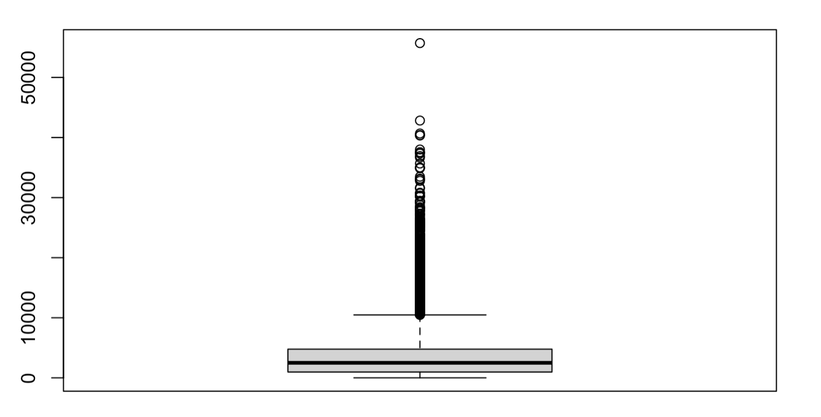
EXPLORATORY ANALYSIS
Plot all the numerical variables (histogram, scatterplot, barplot, boxplots)
Plot the boxplots/ bar plots of all the variables based on COST

Slide 7
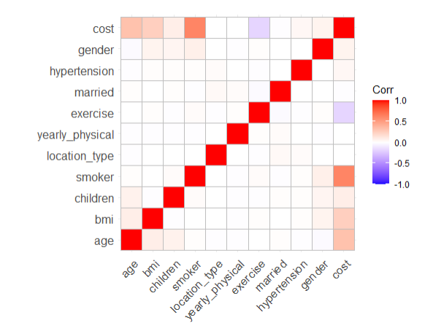
CORRELATION PLOT

Slide 8
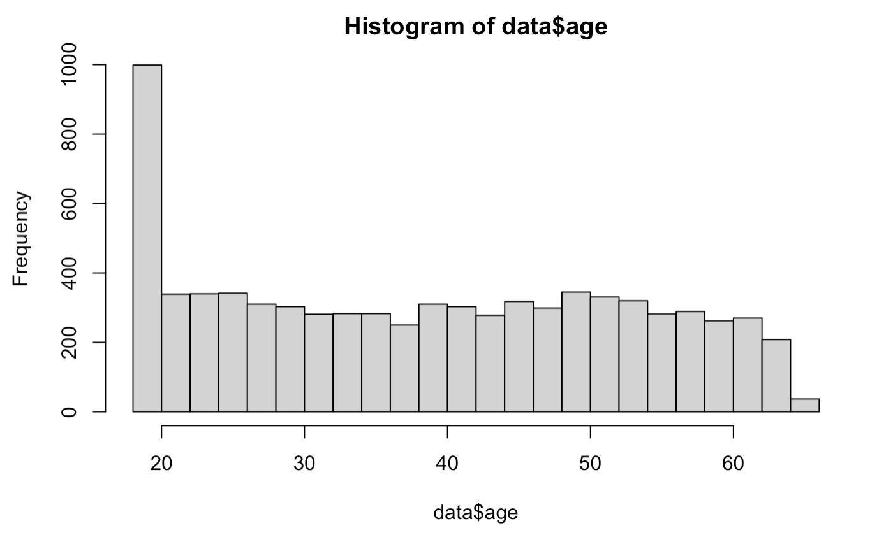
Histogram of age variable

Slide 9
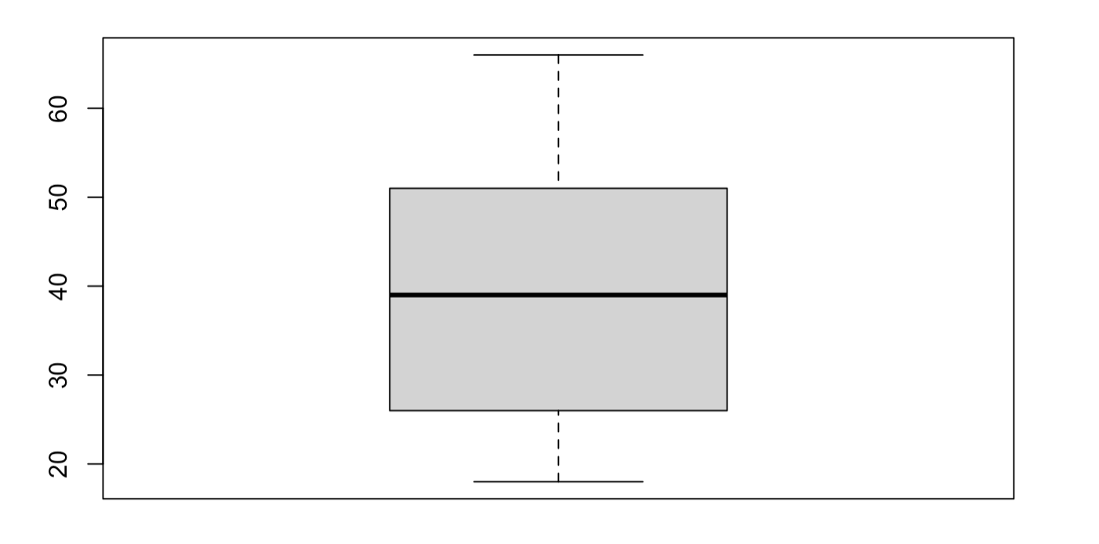
Boxplot of age variable

Slide 10
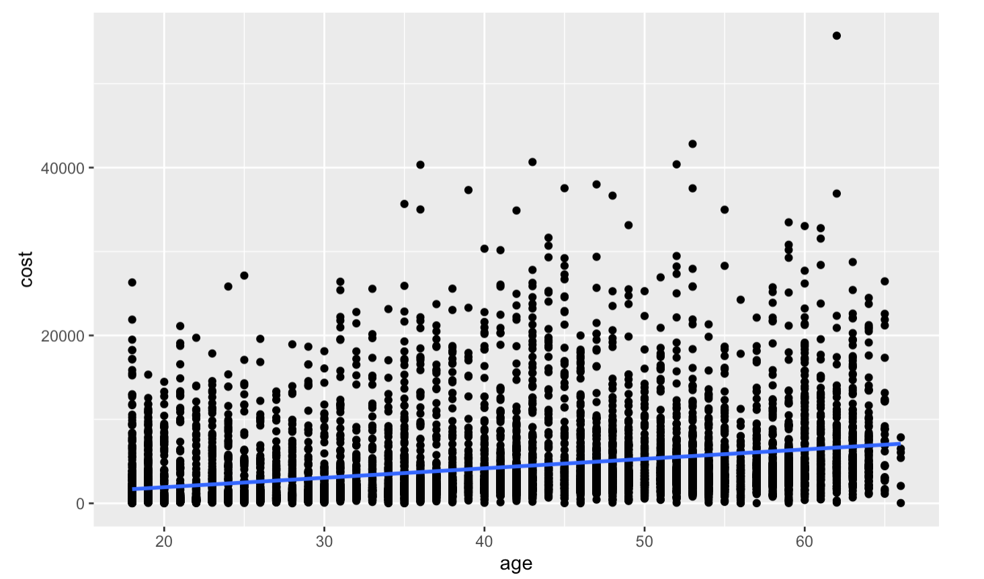
Scatterplot of age against cost

Slide 11
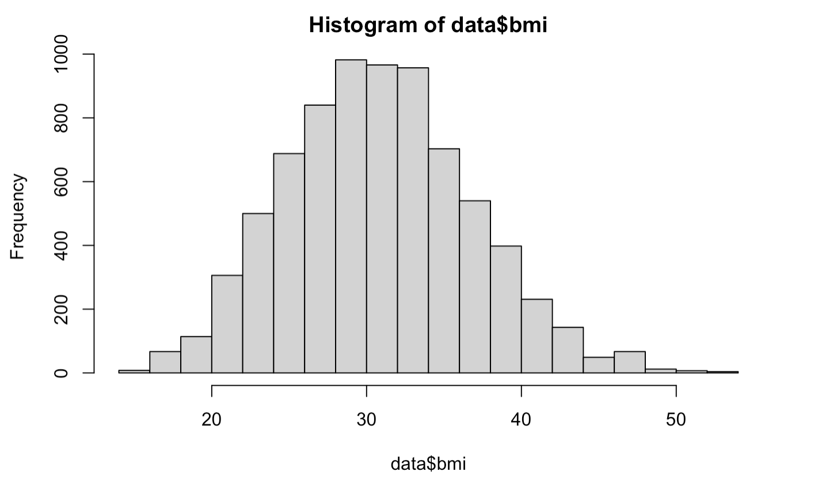
Histogram of bmi variable

Slide 12
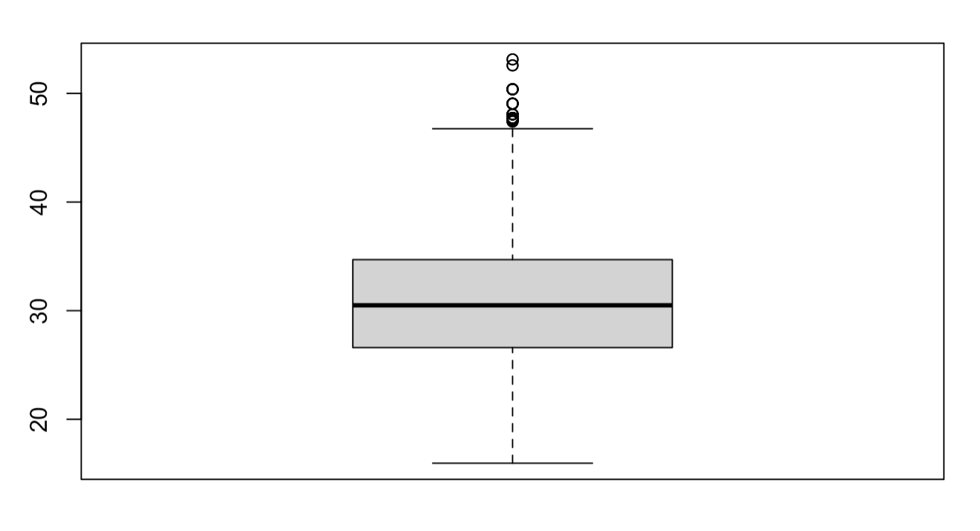
Boxplot of bmi variable

Slide 13
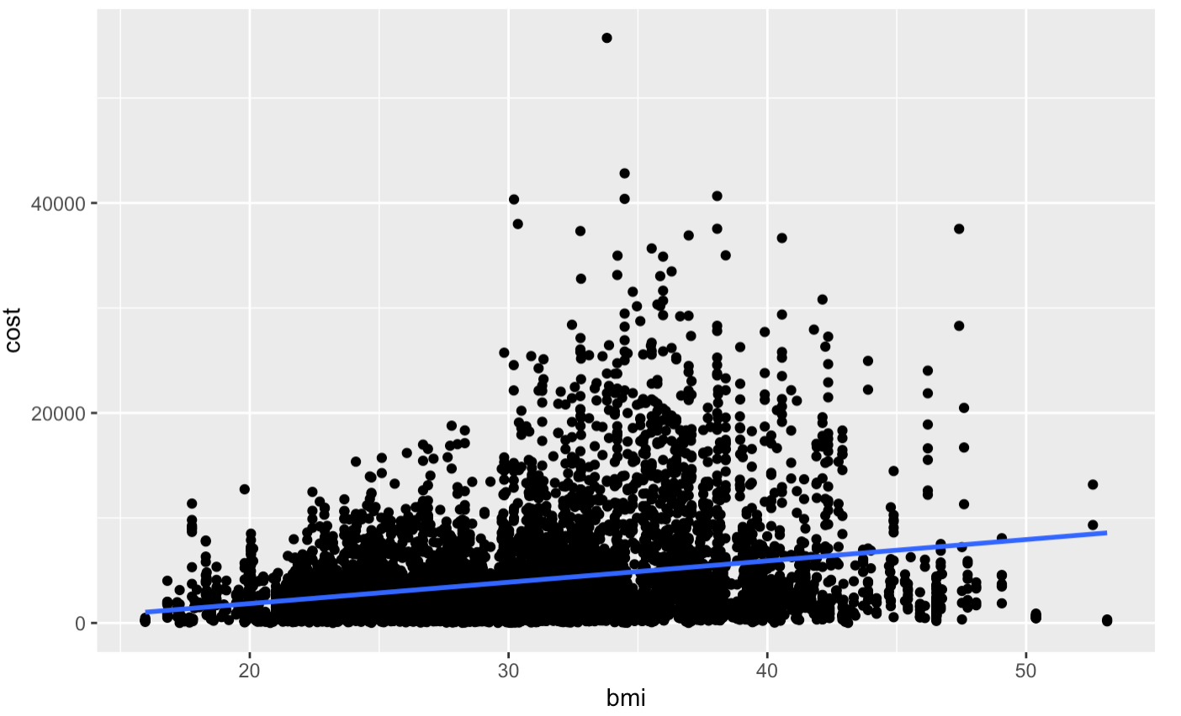
Scatterplot of bmi against cost

Slide 14
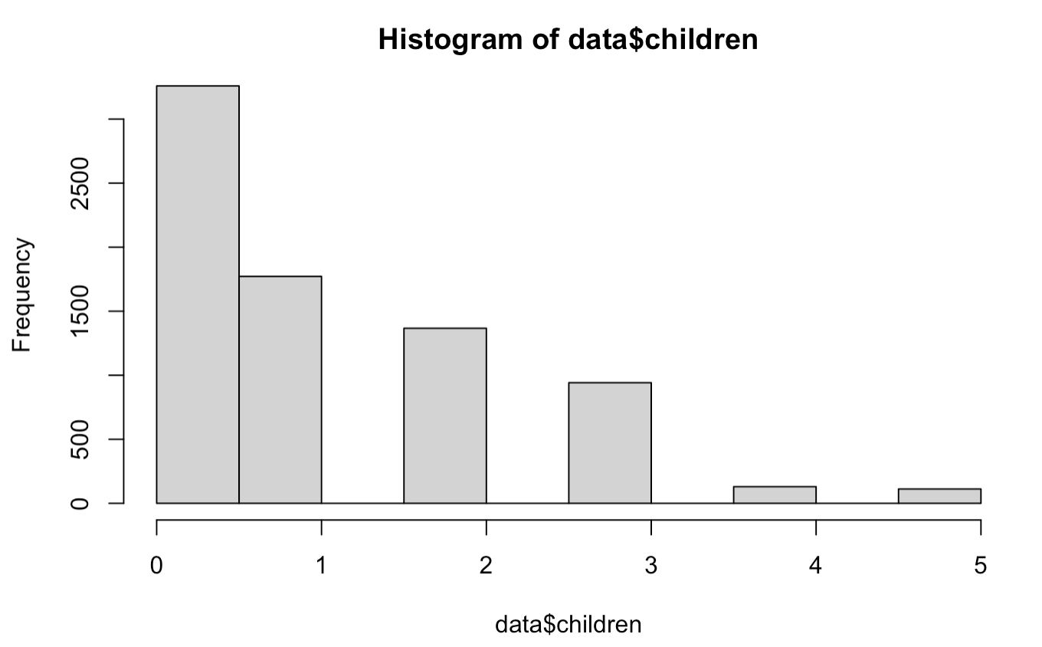
Histogram of children variable

Slide 15
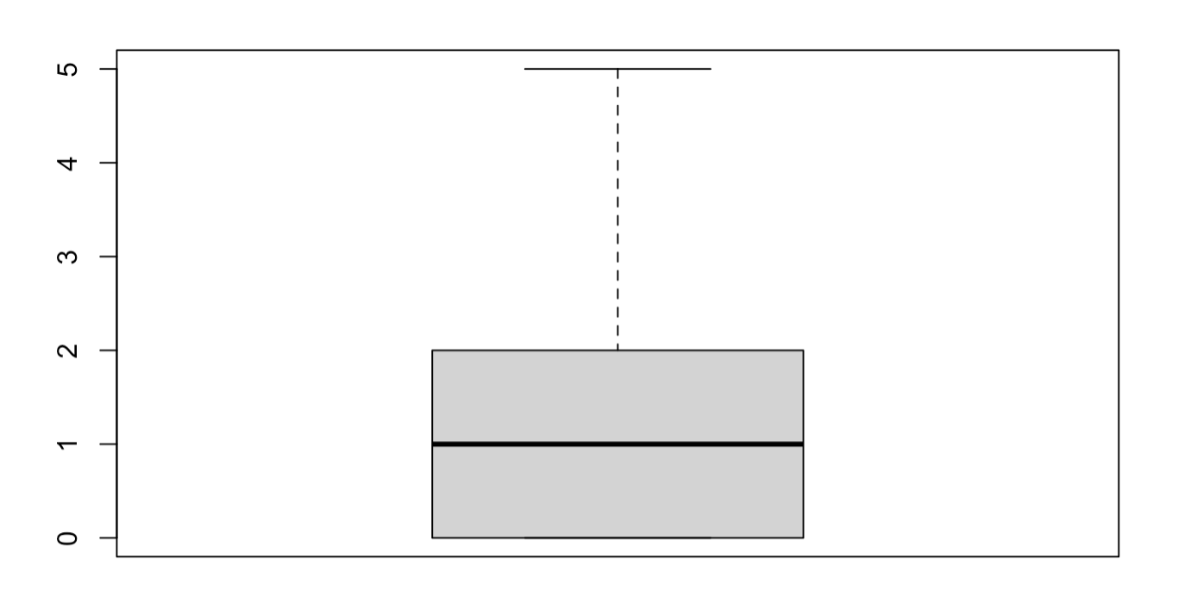
Boxplot of children variable

Slide 16
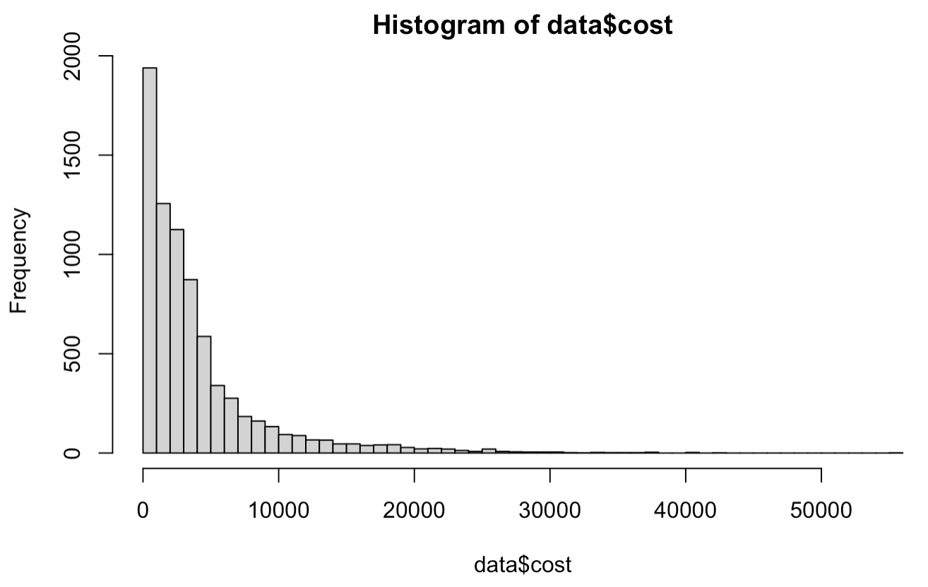
Histogram of cost variable

Slide 17
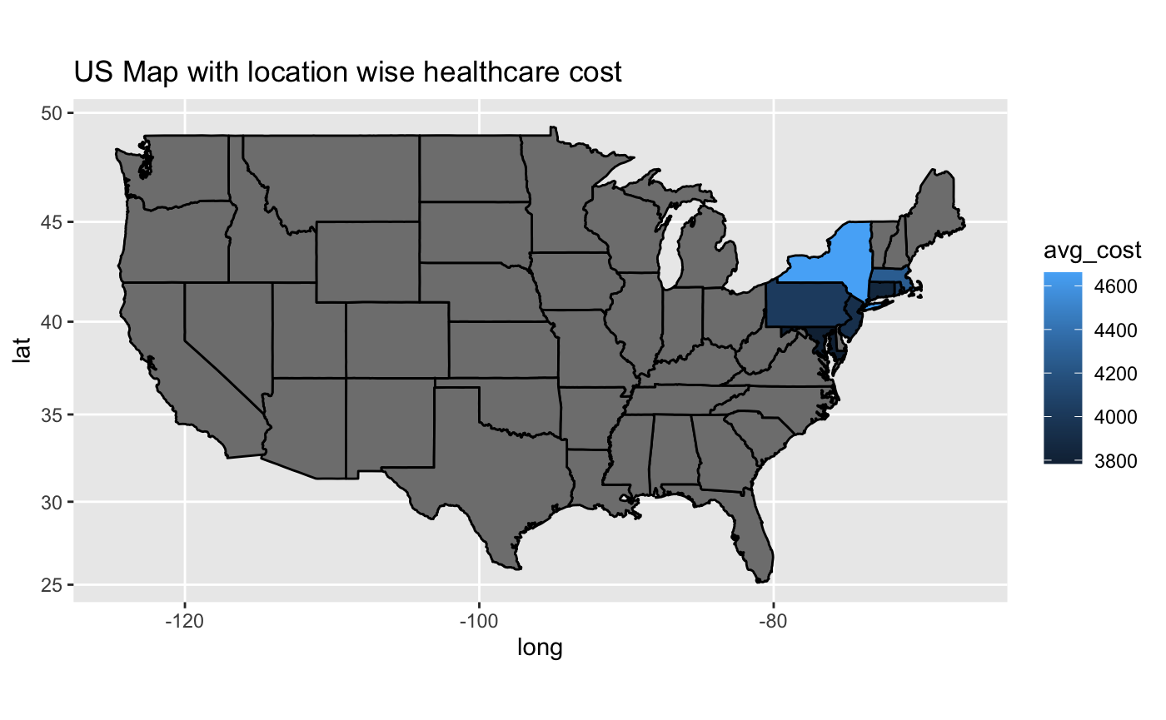
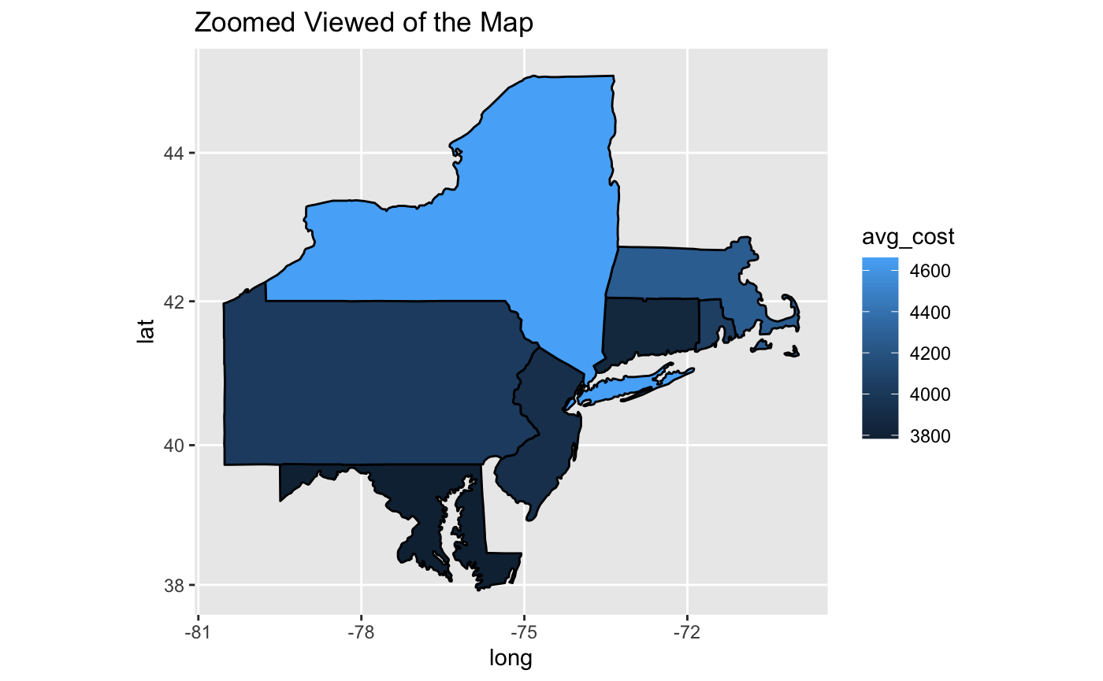
Map Projection showing expensive/Non expensive

Slide 18
Data Modelling
Applied SVM and Linear model on target variable, other category variables.
Interpreted results obtained: Important features, their effect on target variable and confusion matrix for accuracy
Tried to implement Lasso regression model to predict cost.

Slide 19

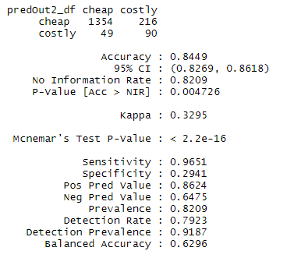
RESULTS
LINEAR MODEL
The accuracy of fit for the predicted values is 57% Approx.
SUPPORT VECTOR MACHINE
Sensitivity of 96% which shows the proportion of positive results out of the number of samples which were actually positive.
Accuracy of 85% which shows the predicted values of Expensive variable would be 85% accurate.

Slide 20
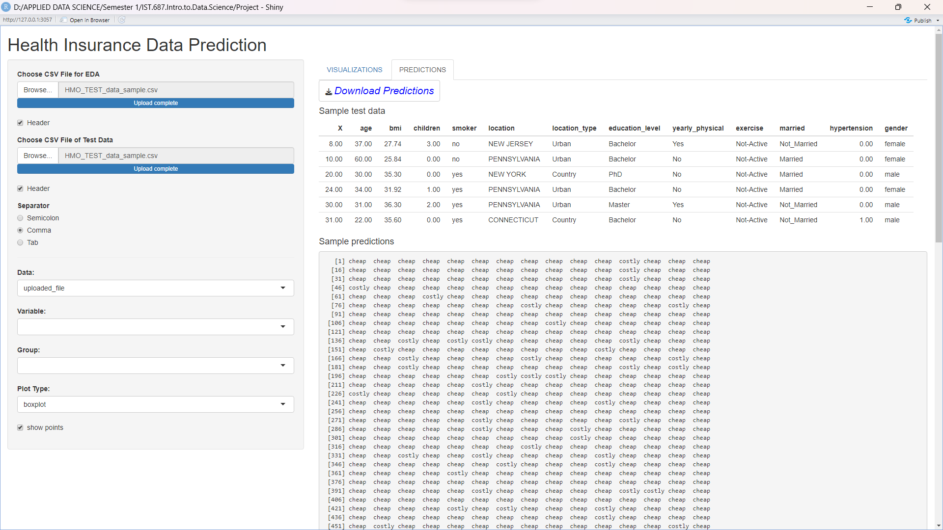
HealthCare Cost Data Analyzer

Slide 21
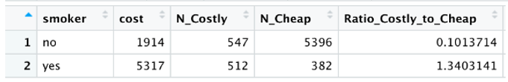
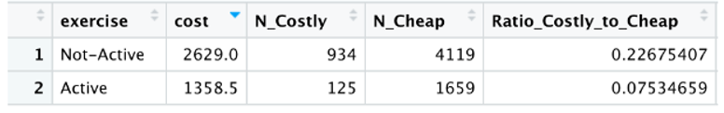
INSIGHTS AND RECOMMENDATIONS
It is observed that smokers tend to have about 14 times higher cost of healthcare, signifying greater amount of health problems. Awareness programs followed by rehab/group therapy sessions can be implemented to promote quitting of smoking habit.
People who doesn’t exercise (inactive) tends to have close to 3 times higher healthcare bills. This is also a reminder of the correlation between unhealthy lifestyle and higher healthcare cost. Promoting a culture of physical activity and implementing cost-effective gyms, group workout sessions etc. is a necessity.

Slide 22
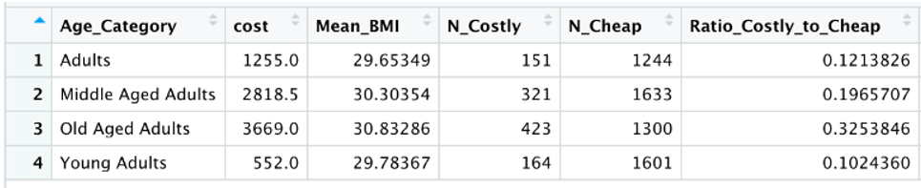
INSIGHTS AND RECOMMENDATIONS
We can also see higher healthcare costs for the old age category. Age related health problems are prevalent in this age category and hence they tend to spend more on healthcare than others. Better and efficient healthcare system for older people should be considered.
RECOMMENDATIONS
HMO can reduce the healthcare costs by customizing insurance plans by including the group therapy expenses in the premium. This will attract less investment and could help reduce the smoking habits.
We also recommend inclusion of fitness plans in the premium so that people remain physically active without having to spend extra on fitness plans.

Slide 23
THANK YOU

Slide 24

QUESTIONS

